Slide 1
Security in Application Development
Presenter
Nikhil Shah

Slide 2
Application security ensures that software is protected from threats and vulnerabilities across the entire Software Development Life Cycle (SDLC).
It is an Important phase of testing in Software lifecycle.
Let us understand different areas of security which needs to be considered during software lifecycle

Slide 3
Secure Software Development Lifecycle (SSDLC)
Planning: Identify security requirements & compliance needs (e.g., GDPR, HIPAA).
Design: Apply secure design principles (least privilege, defense-in-depth).
Implementation: Follow secure coding standards.
Testing: Perform static & dynamic application security testing (SAST, DAST).
Deployment: Harden environments and enable monitoring.
Maintenance: Regular patching, vulnerability scanning, and incident response.

Slide 4
Core Security Principles
Confidentiality: Data must be accessible only to authorized users.
Integrity: Data should not be altered without authorization.
Availability: Systems must remain accessible and functional.
Authentication: Verify user identity (passwords, MFA, biometrics).
Authorization: Control user access levels (RBAC, ABAC).
Non-repudiation: Users cannot deny actions (logs, digital signatures).

Slide 5
OWASP
OWASP, which stands for the Open Worldwide Application Security Project, is a non-profit foundation that works to improve the security of software.
It's a global community that provides free resources, including documentation, tools, and events, to help organizations and individuals build and maintain secure applications.
A key contribution from OWASP is the OWASP Top 10, a list of the most critical web application security risks

Slide 6
Common Application Threats
OWASP Top 10 Vulnerabilities:
Broken Access Control
Cryptographic Failures
Injection (SQL/NoSQL/Command)
Insecure Design
Security Misconfiguration
Vulnerable & Outdated Components
Identification & Authentication Failures
Software & Data Integrity Failures
Security Logging & Monitoring Failures
Server-Side Request Forgery (SSRF)

Slide 7
Best Practices
Use secure coding guidelines (e.g., OWASP, CERT).
Apply input validation & output encoding to prevent injection.
Implement encryption (TLS for data in transit, AES for data at rest).
Keep dependencies up to date and use Software Composition Analysis (SCA).
Apply least privilege access for users and services.
Regularly conduct penetration testing.
Use DevSecOps to integrate security into CI/CD pipelines.
Enable logging & monitoring with real-time alerting.

Slide 8
Common Tools & Technologies
SAST: SonarQube, Fortify, Checkmarx
DAST: OWASP ZAP, Burp Suite
SCA: Snyk, WhiteSource
Container Security: Aqua, Twistlock
Cloud Security: IAM policies, KMS, Security Groups

Slide 9
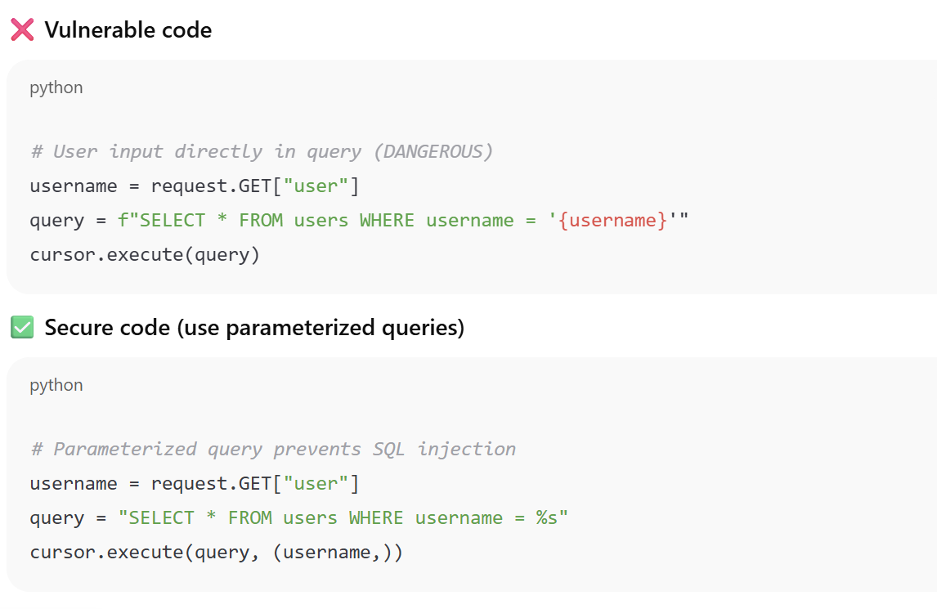
Examples
SQL Injection

Slide 10
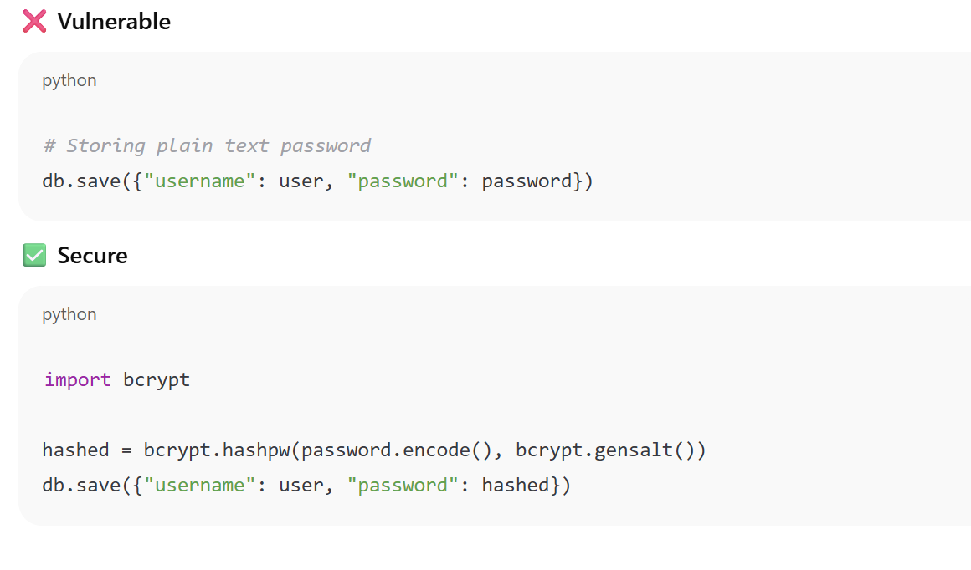
2. Password Storage

Slide 11
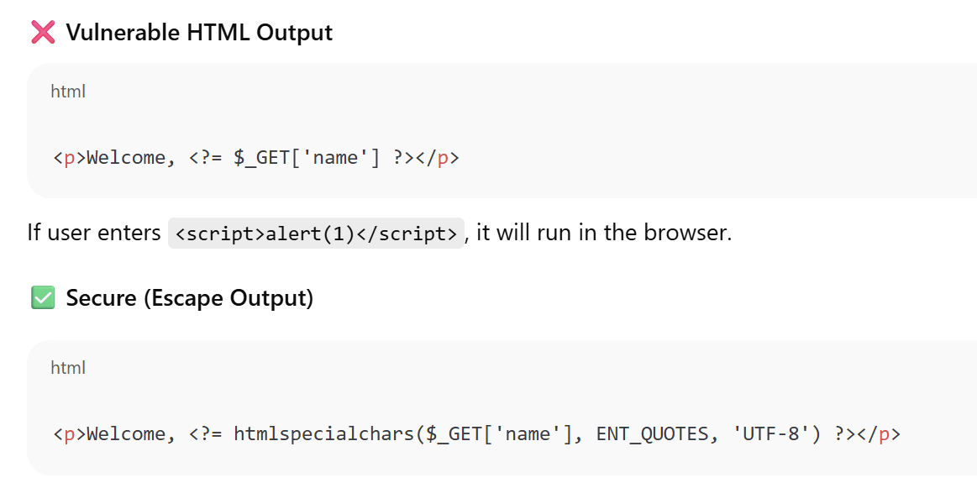
3. Cross-Site Scripting (XSS)

Slide 12
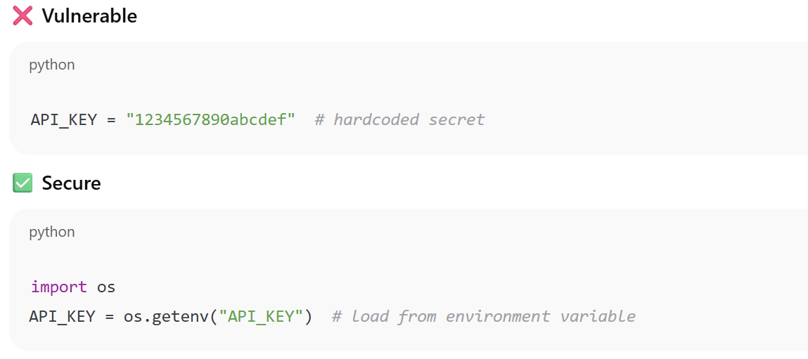
4. Hardcoded Secrets

Slide 13
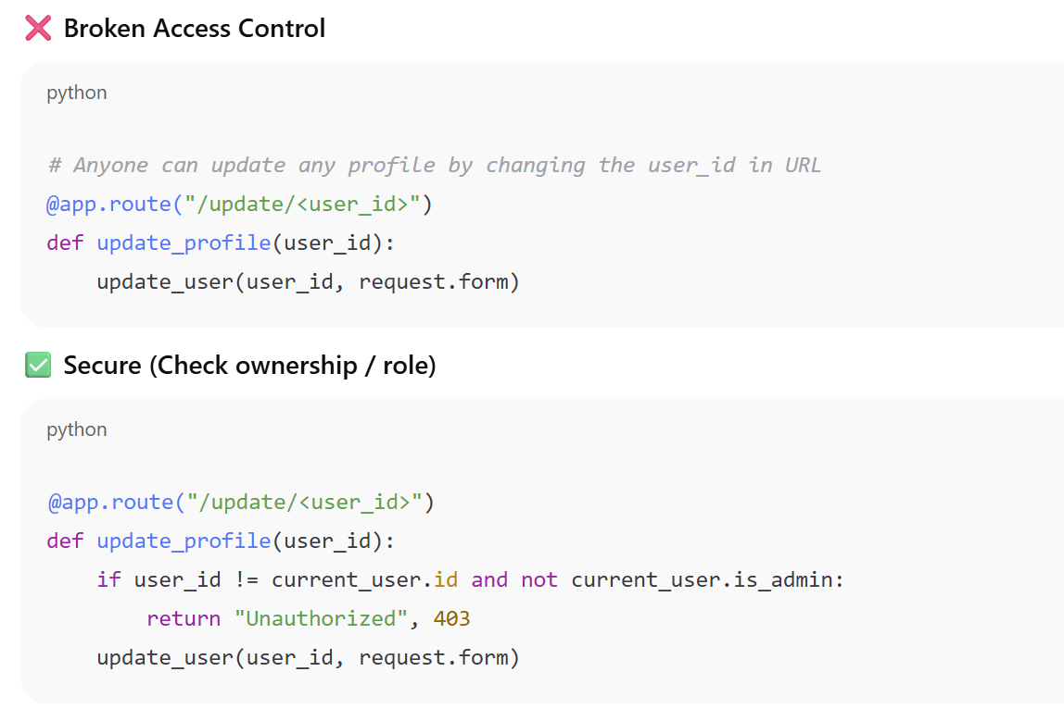
5. Access Control

Slide 14
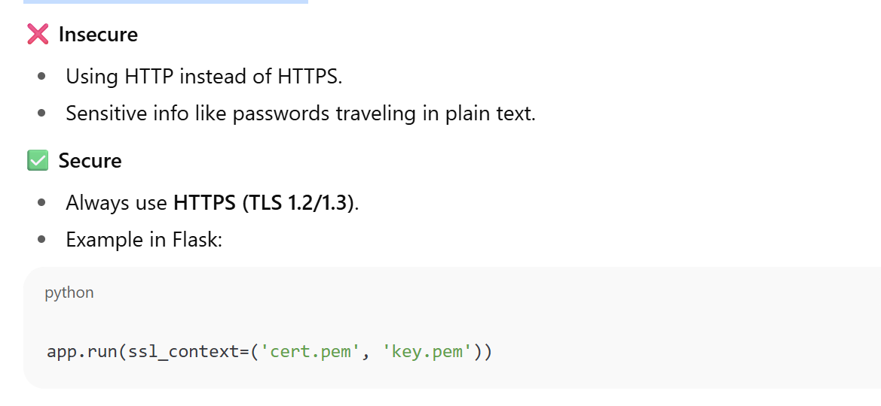
6. Transport Layer Security

Slide 15
Thank you

